Slide 1

Object Selection
_______________________
_______________________
Student:
Nguyen Van Khoi
Tran Hoang Nam
Supervisor:
MSc. Tu Trung Hieu

Slide 2
Introduction
Literature review
Problem statement
Interactive graph cut segmentation
Silent Lazy Snapping solution
Experimental results
Future direction
Question and answer

Slide 3
Image selection
An image is a set of sub-images that sometimes referred to as regions-of-interest, ROIs, or simply regions.
One of the problem in image processing is image selection – how to cut out or select an area for later specific image processing operations.

Slide 4
Interactive single-image segmentation
Interactive single-image segmentation (image cutout or foreground/background separation), one of the typical case in region selection problem, is to select the object (e.g. human, flower, etc.) from the background that based on samples provided by the user.

Slide 5
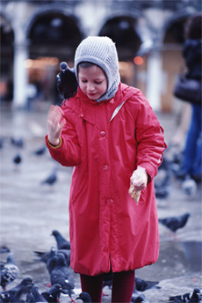
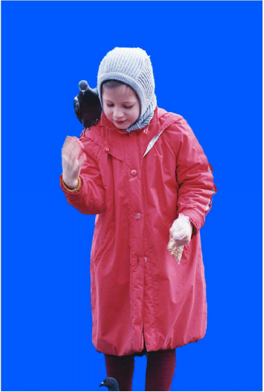
Image segmentation from Lazy Snapping paper

Slide 6
Introduction
Literature review
Problem statement
Interactive graph cut segmentation
Silent Lazy Snapping solution
Experimental results
Future direction
Question and answer

Slide 7
Literature review
Greig et al, 1989: the first using min-cut max-flow algorithm to optimize certain energy function in vision.
Boykov and Jolly, 2001: basing on the work of Greig, finding optimal segmentation which satisfies hard constraints imposed by user and soft constraints combining both region and boundary properties.
Li, Tang, Sun and Shum, 2004: improving the method of Boykov and Jolly, working on super-pixel with an extra boundary-editing step.
Rother, Kolgomorov and Blake, 2004: the iterated version of Boykov and Jolly’s works, using color and contrast information with border matting for optimize the boundary.

Slide 8
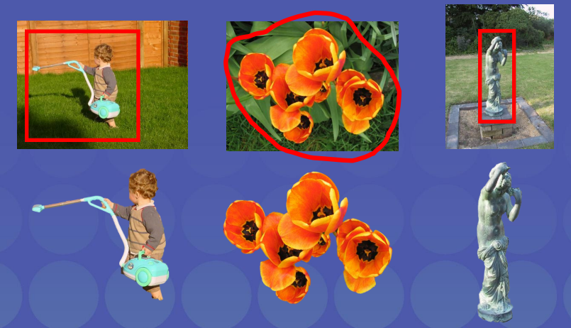
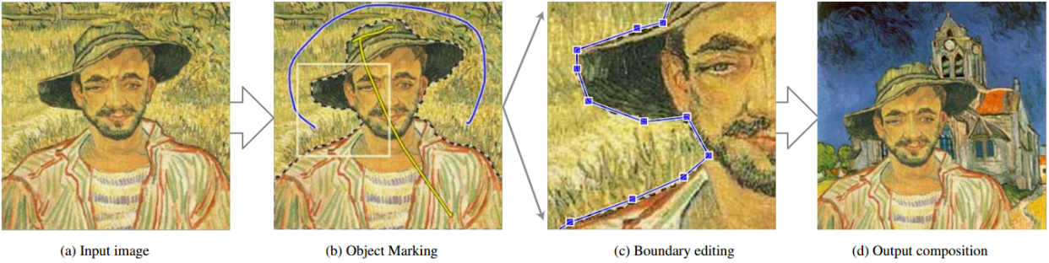
Examples
Lazy Snapping
GrabCut

Slide 9
Introduction
Literature review
Problem statement
Interactive graph cut segmentation
Silent Lazy Snapping solution
Experimental results
Future direction
Question and answer

Slide 10
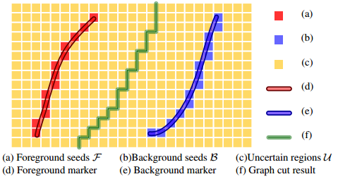
Problem statement
Suppose we have an input image N and some sets of pixels:
Foreground set : set of all pixels that are sample for the object.
Background set : set of all pixels that are sample for the background.
Uncertain set : set of all pixels that are not in the both fore/background set.
How to figure out all pixels belong to the object in the image and separate them from the background?

Slide 11
Binary images: foreground, background
A binary image is an image in which each pixel belongs to one of only two possible discrete logical value: 1 or 0. In our problem:
The logical value 1 is known as “object”.
The logical value 0 is known as “not object”.
We define the set of pixels which logical value is 1/0 as the temp foreground/background pixel.

Slide 12
Binary labelling problem
For all image pixels, we need to assign a unique label
If a pixel is in the foreground/background set, the label of it is 1/0.
If a pixel is not in the foreground and background set, the temporary label of it is “uncertain”.
How to find a way to label all pixels in the image so that all pixels belong to object we want to select have same label, and so do to the another pixel?

Slide 13
Binary labelling problem - Constraint
Data constraint
Prior constraint
If a pixel has it colors similar to at least one pixel belong to foreground seeds, it is more likely to get foreground label, and so do with background seeds.
Pixels that belong to the object tend to group together, and so do with pixels that belong to background.

Slide 14
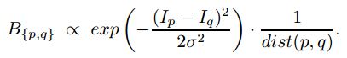
Binary labelling problem
Minimize the energy function (Greig et al., 1989)
Where know as a balancing parameter between data constraint and the prior constraint:
The larger lambda, the less discontinuities in the optimal labeling L.
The smaller lambda, the more optimal labeling L.

Slide 15
Introduction
Literature review
Problem statement
Interactive graph cut segmentation
Silent Lazy Snapping solution
Experimental results
Future direction
Question and answer

Slide 16
Energy function

Slide 17
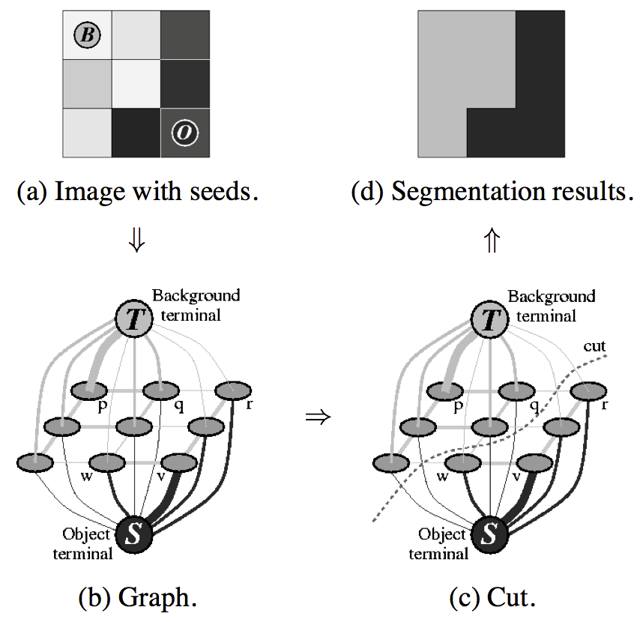
Graph cut construction
A simple segmentation example for a 3x3 image.

Slide 18
Energy function (cont.)

Slide 19
Detailed implementation
Negative log-likelihood of intensity for regional term
Ad hoc function for boundary term
Max-flow algorithm provided by Boykov and Kolgomorov (2001)

Slide 20
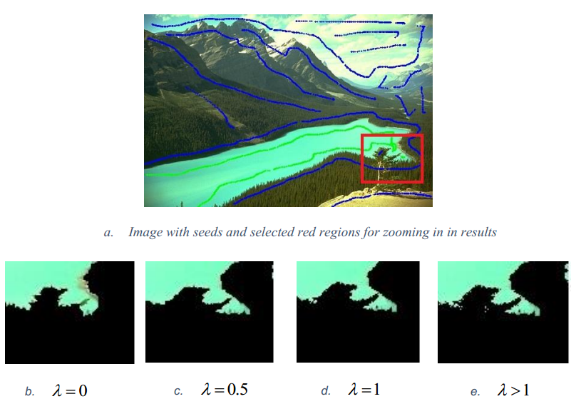
Sample result and comment

Slide 21
Introduction
Literature review
Problem statement
Interactive graph cut segmentation
Silent Lazy Snapping solution
Experimental results
Future direction
Question and answer

Slide 22
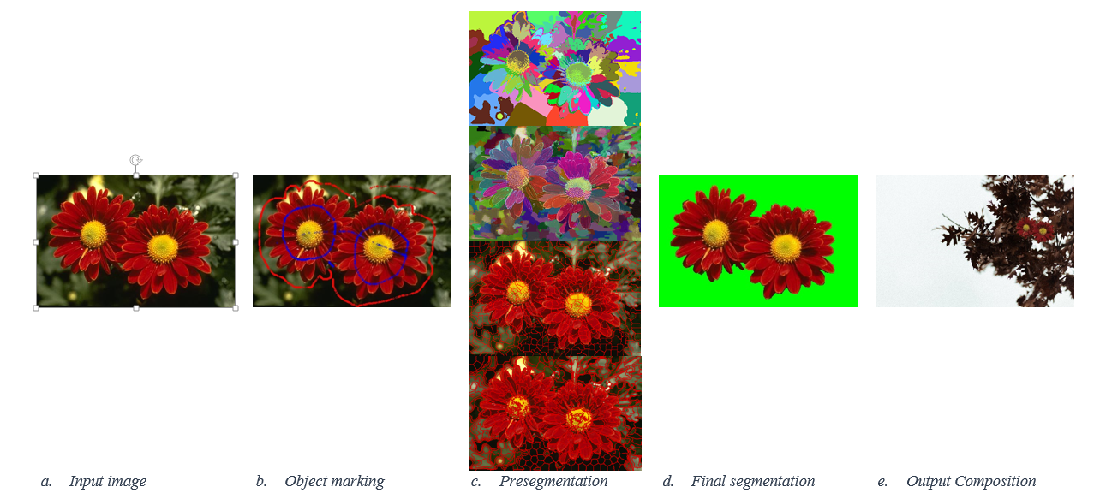
Silent Lazy Snapping model

Slide 23
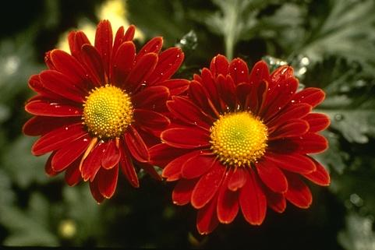
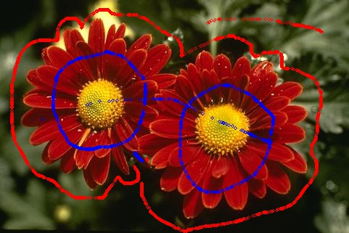
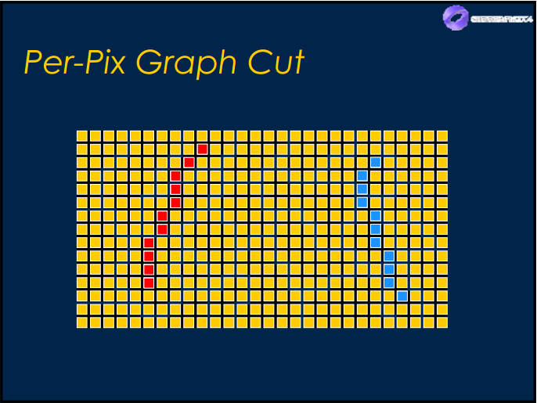
Step 1: Sample definition

Slide 24
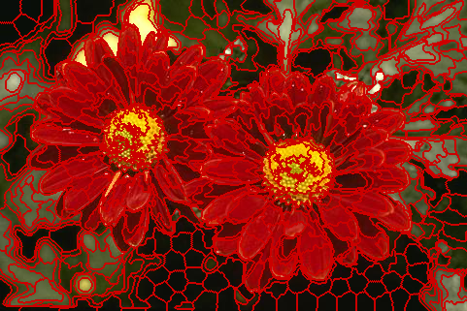
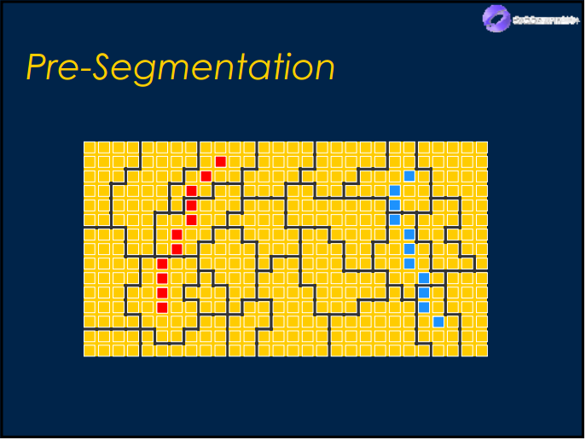
Step 2: Pre-segmentation

Slide 25
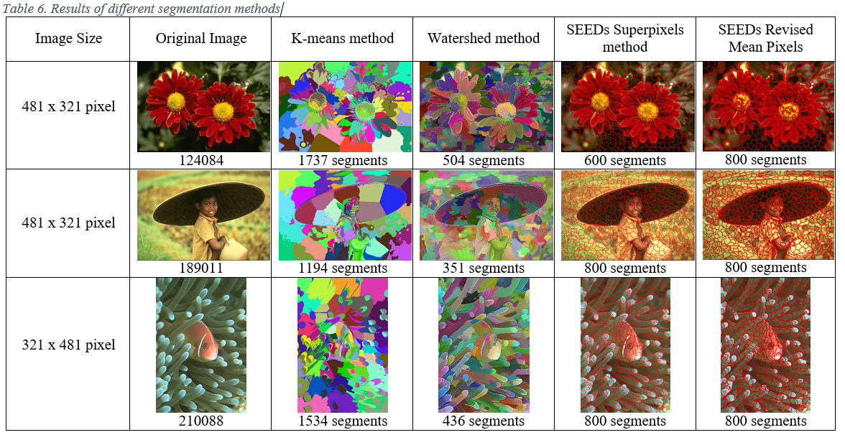
Experimental result on pre-segmentation (1)

Slide 26
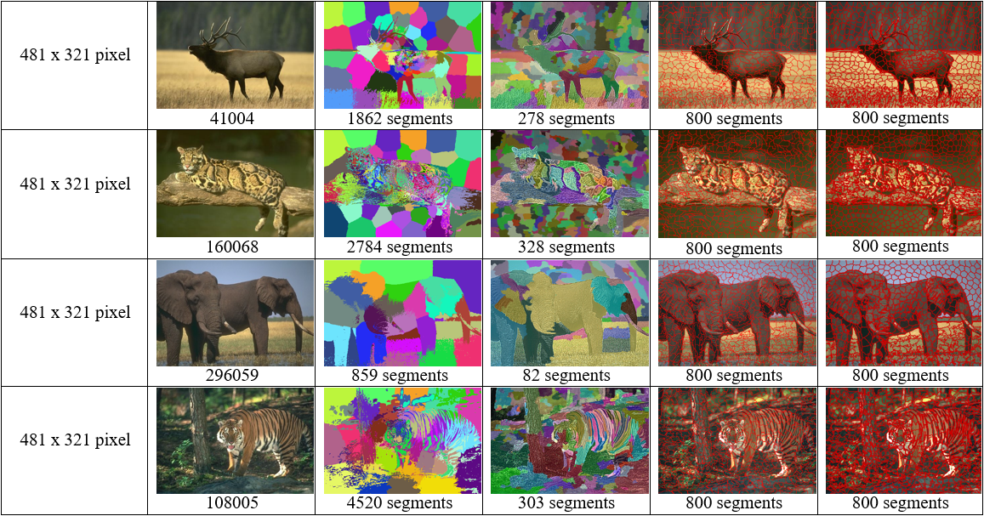
Experimental result on pre-segmentation (2)

Slide 27
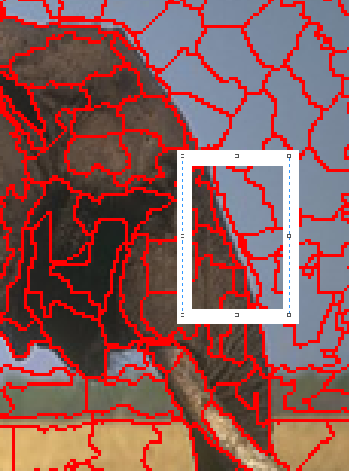
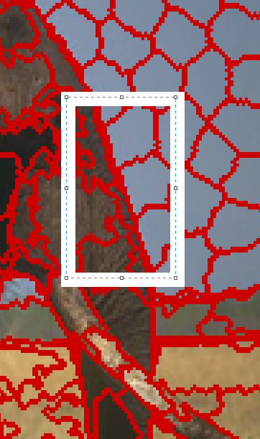
Experimental result on pre-segmentation (3)

Slide 28
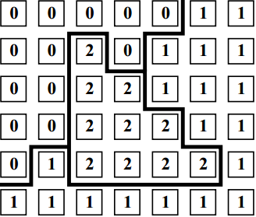
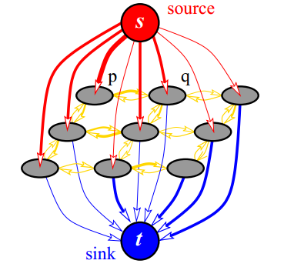
Step 3: Graph initialization

Slide 29
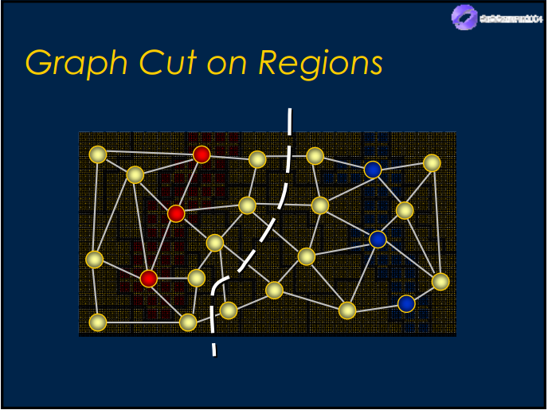
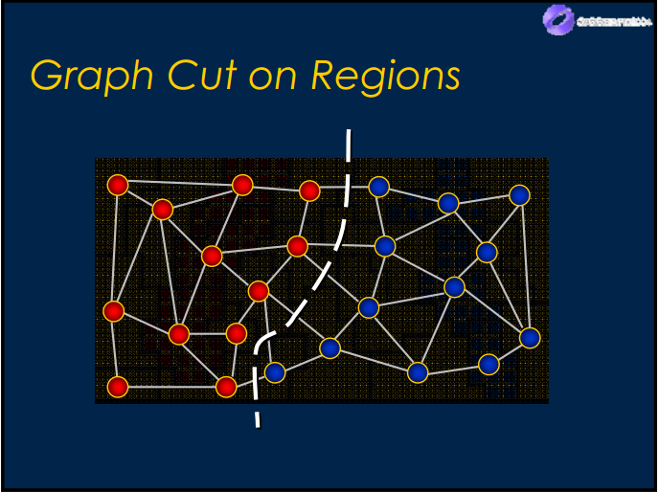
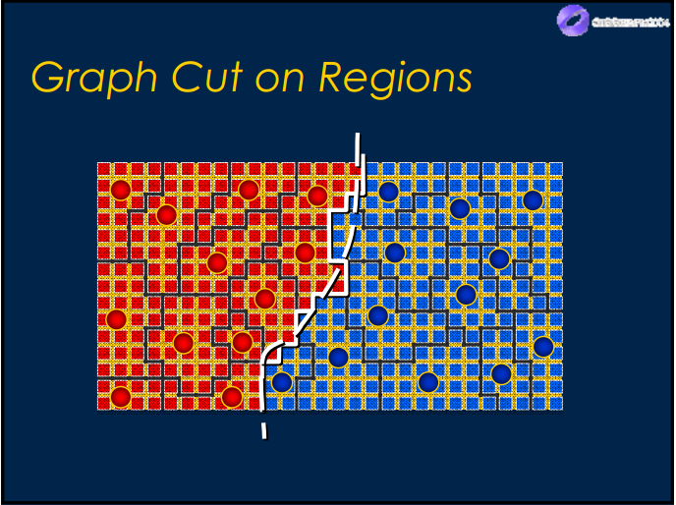

Step 4: Graph cut and final segmentation

Slide 30
Introduction
Literature review
Problem statement
Interactive graph cut segmentation
Silent Lazy Snapping solution
Experimental results
Future direction
Question and answer

Slide 31
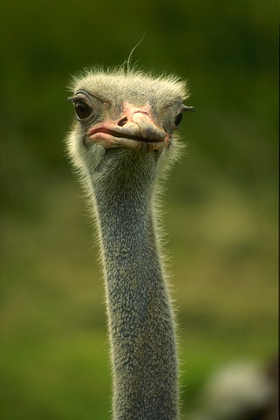
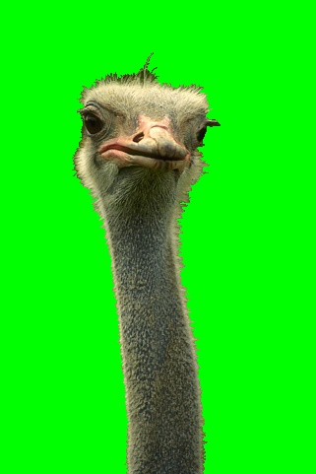
Limitation 1: Pixel loss in thin area
189080 with samples
Final segmentation

Slide 32
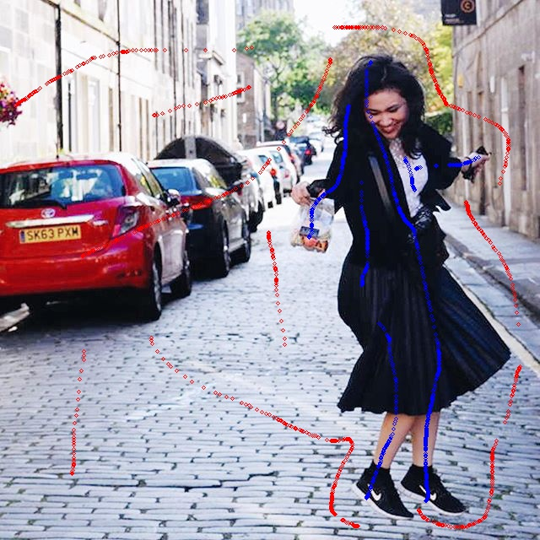
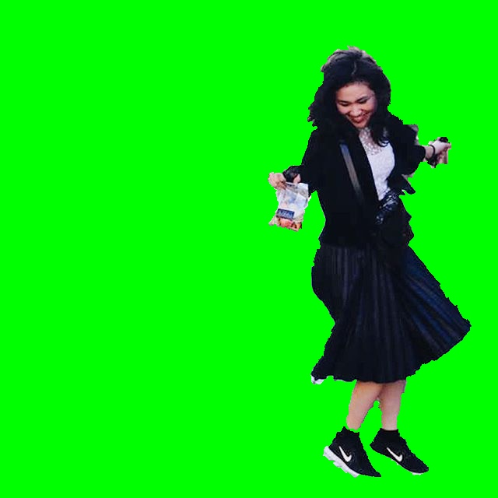
Limitation 2: Unsmooth boundary
Dancing_Emily with samples
Final segmentation

Slide 33
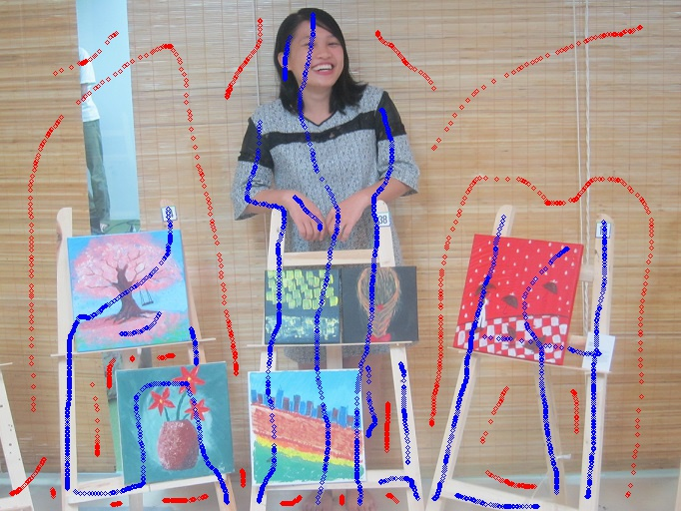
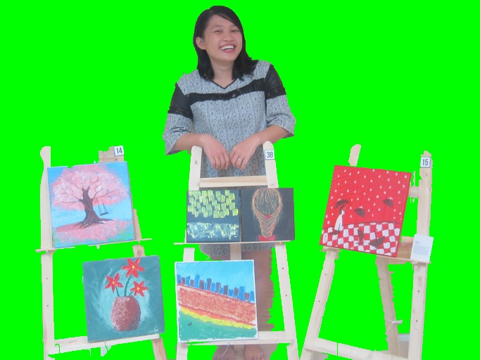
Limitation 3: Poor performance when foreground and background have similar color distribution
Vango with samples
Final segmentation

Slide 34
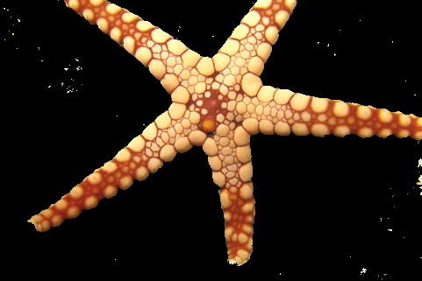
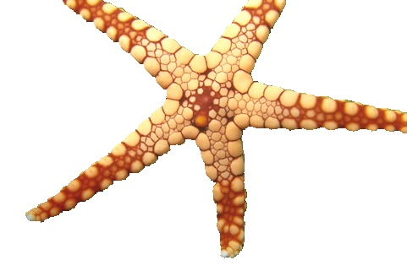
Berkeley dataset – 12003.jpg
Interactive Graph Cut
Silent Lazy Snapping

Slide 35

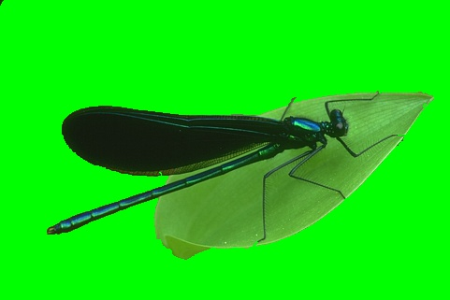
Berkeley dataset – 35070.jpg
Interactive Graph Cut
Silent Lazy Snapping

Slide 36


Berkeley dataset – 176035.jpg
Interactive Graph Cut
Silent Lazy Snapping

Slide 37

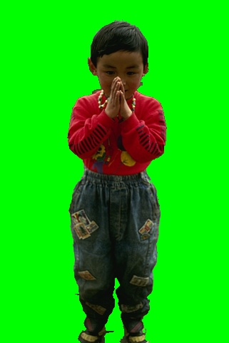
Berkeley dataset – 187029.jpg
Interactive Graph Cut
Silent Lazy Snapping

Slide 38
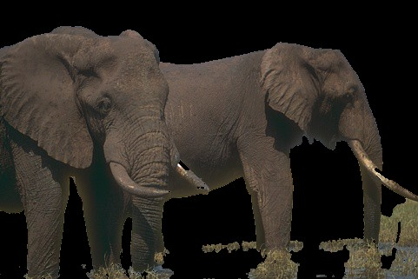
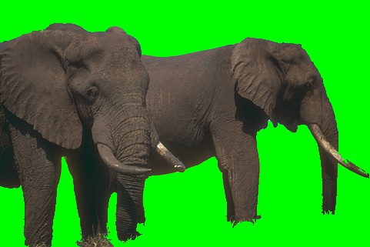
Berkeley dataset – 207056.jpg
Interactive Graph Cut
Silent Lazy Snapping

Slide 39
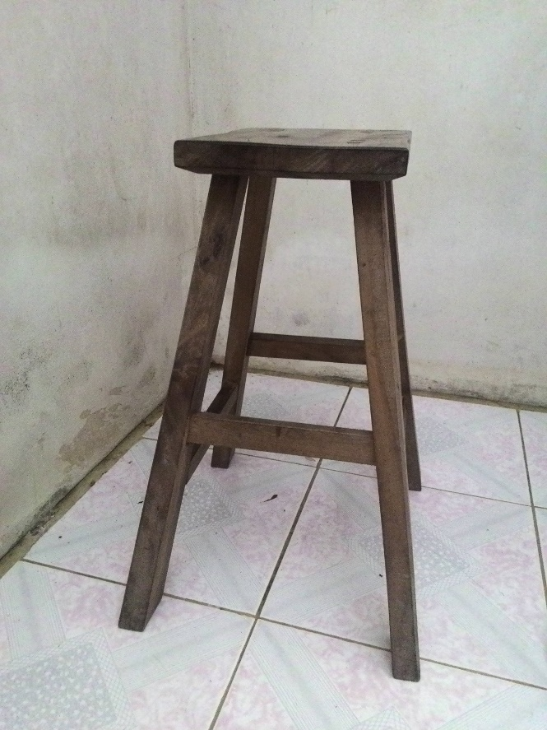

Khoi’s dataset – 5.jpg
Original Image
Interactive Graph Cut

Slide 40
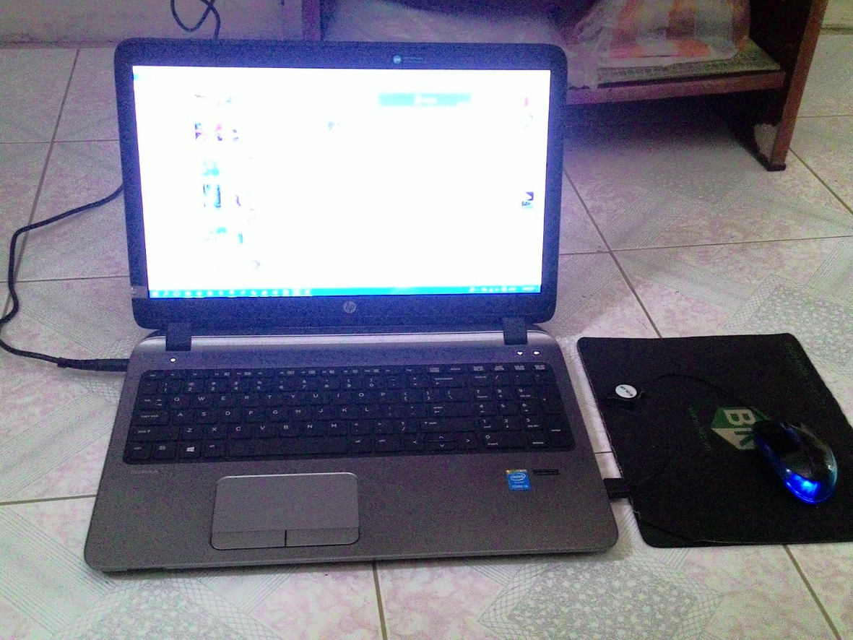
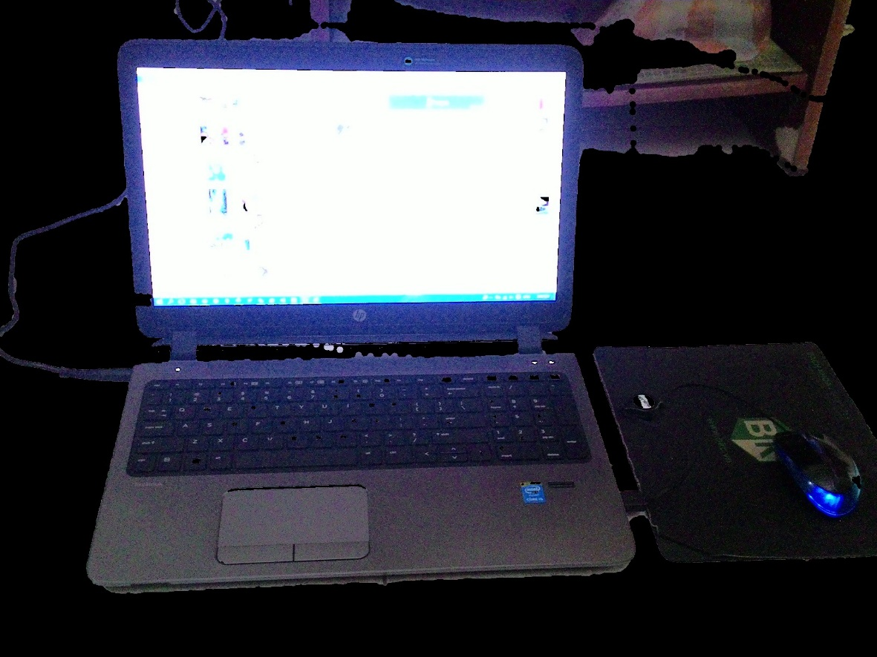
Khoi’s dataset – 6.jpg
Original Image
Interactive Graph Cut

Slide 41
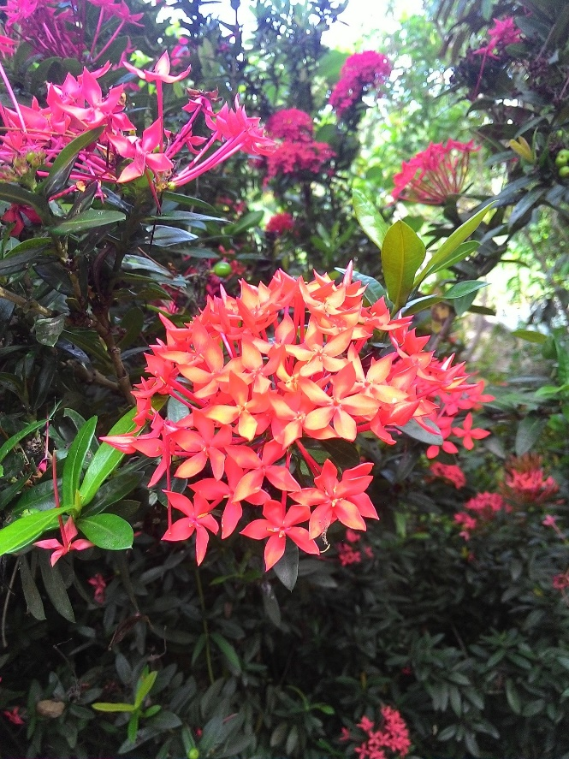

Khoi’s dataset – 7.jpg
Original Image
Interactive Graph Cut

Slide 42
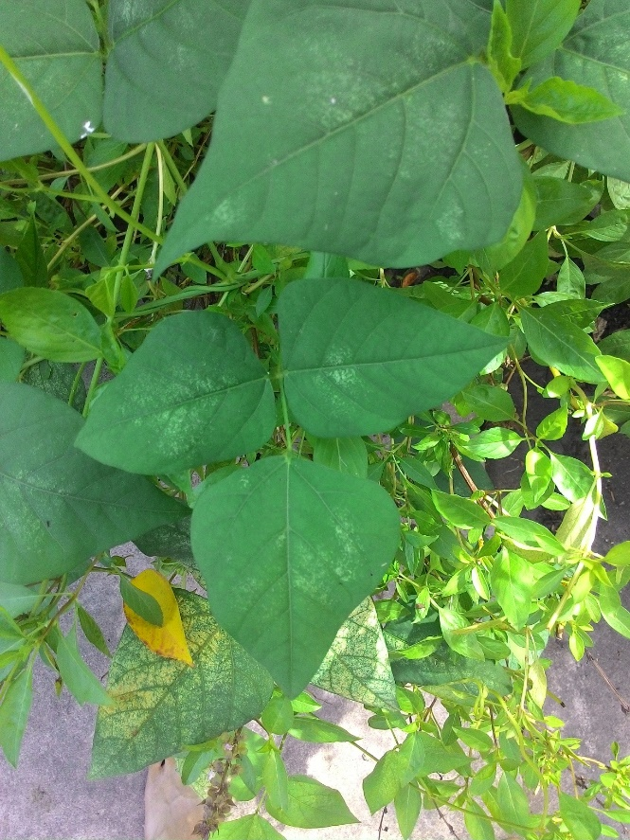

Khoi’s dataset – 8.jpg
Original Image
Interactive Graph Cut

Slide 43
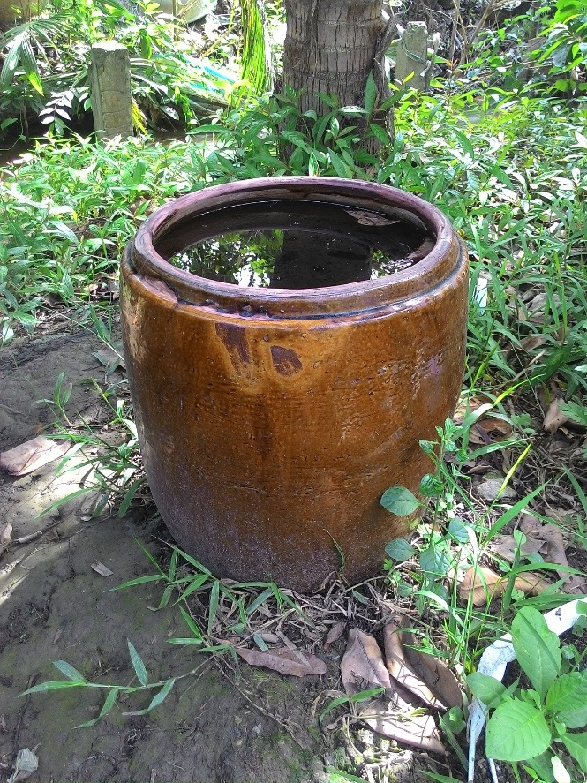
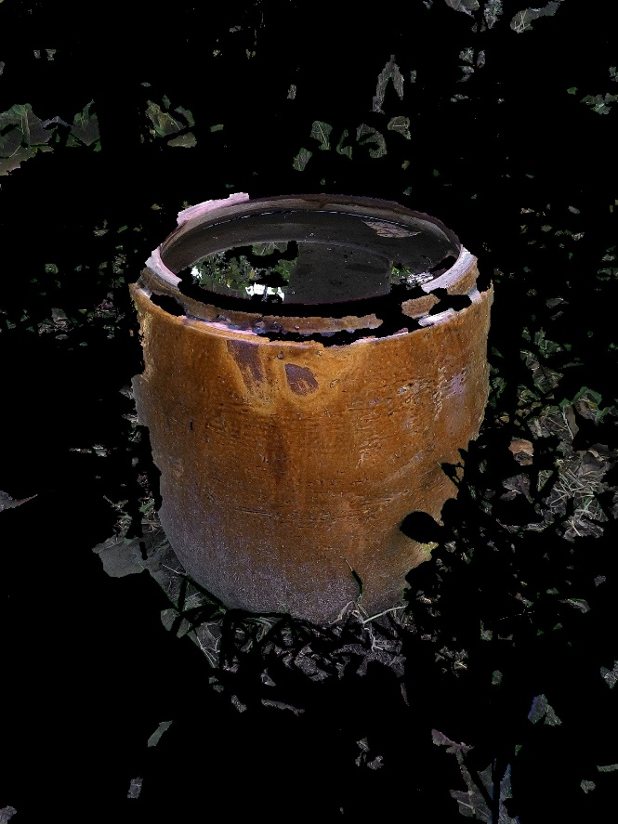
Khoi’s dataset – 9.jpg
Original Image
Interactive Graph Cut

Slide 44

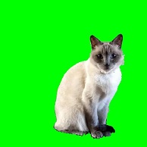
Nam’s dataset – Cat.jpg
Original Image
Silent Lazy Snapping

Slide 45


Nam’s dataset – TrangAn.jpg
Original Image
Silent Lazy Snapping

Slide 46

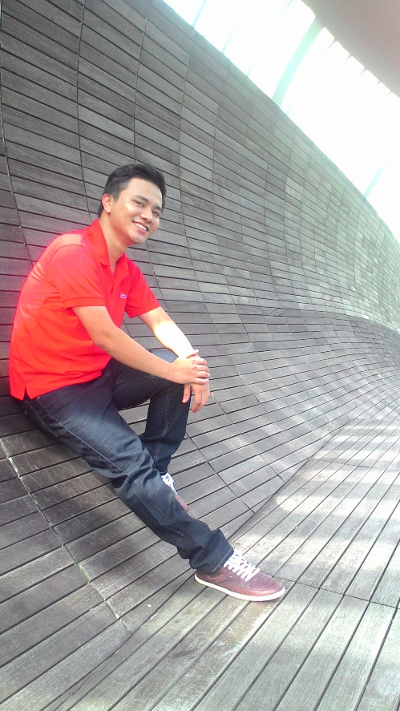
Nam’s dataset – Nam_2.jpg
Original Image
Silent Lazy Snapping

Slide 47

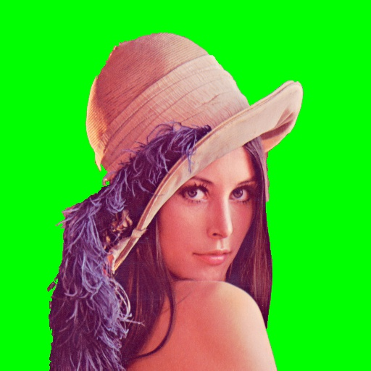
Nam’s dataset – WSpaper.jpg
Original Image
Silent Lazy Snapping

Slide 48
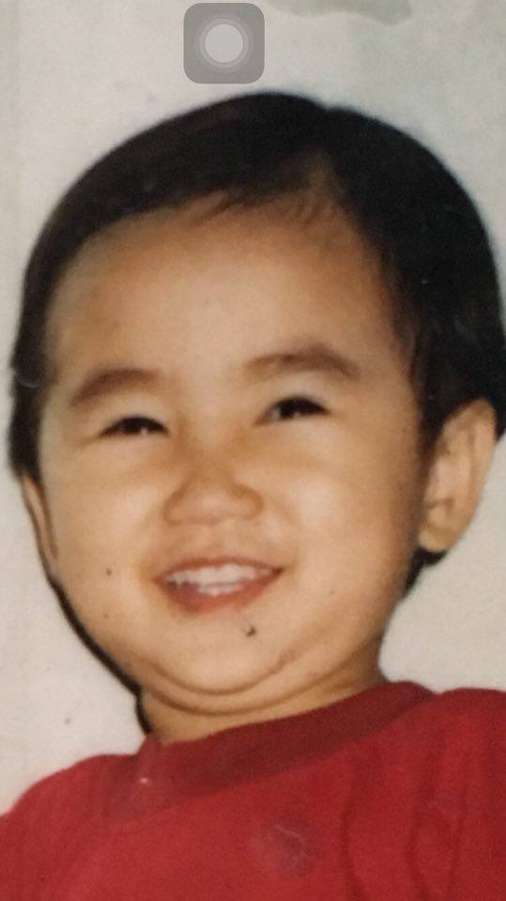

Nam’s dataset – Emily_child.jpg
Original Image
Silent Lazy Snapping

Slide 49
Introduction
Literature review
Problem statement
Interactive graph cut segmentation
Silent Lazy Snapping solution
Experimental results
Future direction
Question and answer

Slide 50
Future works
Graph Cut for Image Segmentation
Lazy Snapping
Try several other feature descriptor (such as HOG, etc.) for achieving the better results
Add GUI options for easier experimenting
Add boundary editing function
Add some filter

Slide 51
Introduction
Literature review
Problem statement
Interactive graph cut segmentation
Silent Lazy Snapping solution
Experimental results
Future direction
Question and answer

Slide 52
THANK YOU FOR LISTENING!

